Slide 1


SEN Information Report
Written September 2025

Slide 2

What is a SEN Information Report?
The School Information Report answers some of the most frequently asked questions about the school’s provision for children with special educational needs or disabilities (often abbreviated to SEND)
It is reviewed annually or when necessary, throughout the year.

Slide 3


What does having a Special Educational Need or Disability mean?
‘A child or young person has SEND (Special Educational Needs and Disabilities) if they have a learning difficulty or disability which calls for special educational provision to be made for them.
A child of compulsory school age or a young person has a learning difficulty or disability if they:
  have a significantly greater difficulty in learning than the majority of others of the same age; or
  have a disability which prevents or hinders them from making use of educational facilities of a kind generally provided for others of the same age in mainstream schools or mainstream post16 institutions.’
  (SEN Code of Practice 2014)

Slide 4




What are the four main areas of need?
The four broad areas of need are:
A child may have difficulties in more than one broad areas of need. These are explained in more detail within the SEN Code of Practice.
Communication and Interaction | Cognition and Learning | Social, Emotional and Mental Health | Sensory and / or physical needs

Slide 5

How do we identify if a child has a Special Educational Need?
We all recognise the importance of identifying SEND early and making effective provision quickly. Pupils attainment is continuously monitored.
We assess each pupil’s skills and levels of attainment when they first come to the school. This builds on any information from the child’s previous early years setting or school.
Where children already have their SEND diagnosed or identified, we will work closely with the family and our partners.
Teachers are supported by the Senior Leadership Team to regularly assess pupils’ progress and attainment throughout the year.
If their progress continues to be slower than expected the teacher and team leaders will work with the family and the SENDCO (Special Educational Needs and Disabilities Coordinator) to carry out a clear analysis of the child’s needs and identify if they need additional support.

Slide 6

What could you do if you think your child has a Special Educational Need?
Please share your concerns as soon as you can.
There are a number of people that you can talk to at school:
      1st - The class teacher
      2nd- The SENDCo
      3rd- The Head Teacher

Slide 7


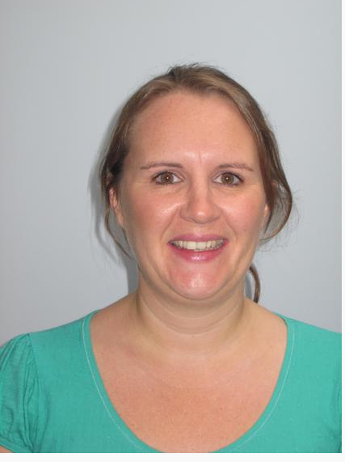

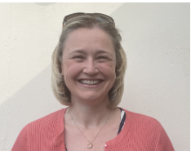
Who can I talk to?
Class Teacher
Mrs Pip Edwards
Mrs Becky Booth
Mrs Clare Walsh
Mrs Sam Wilkinson
Head Teacher
admin@wembury-school.devon.sch.uk
01752 862 459

Slide 8
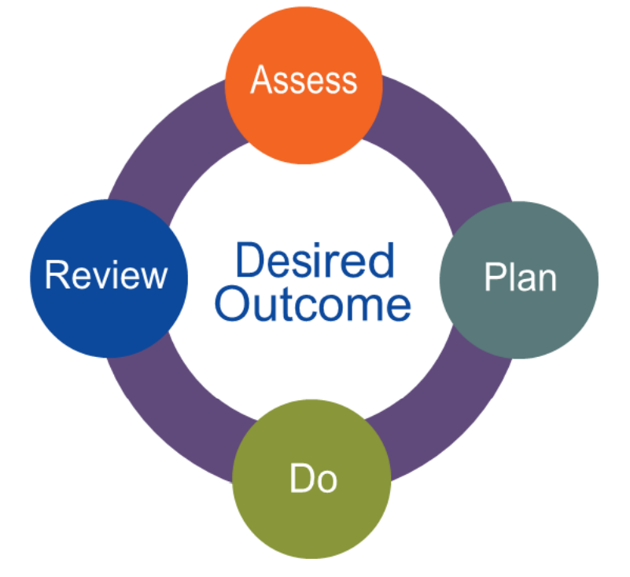
How are children with Special Education Need or Disabilities (SEND) supported?
High Quality Teaching
Home –School Links
Individual Learning Plans
Relational Behaviour Approach
Adaptive Teaching Strategies
Personalised Interventions
Education and Health Care Plan
Adapted School Environment
Team Around Me Meetings
Specialist Agency Support

Slide 9

How do we involve others in meetings about your child?
With your support, we may need to seek referrals to outside agencies such as: Educational Psychology (EP) Communication Interaction Team (CIT), Speech and Language Therapists Multi Agency Support Team (MAST). We may hold a meeting called a Team Around Me (TAM). These meetings are minuted and actions are set.

Slide 10

How do children share their views?
All children are encouraged to share their views with their class teacher, teaching assistant or any adult member of the school team. When an outside agency referral is completed, we record their thoughts and feelings through a One Page Profile (assisted by an adult if required.) If a meeting is held, and it is appropriate, children will share their thoughts and feelings. If this is not appropriate, their thoughts and feelings are shared on their behalf. Children with SEND are invited to attend meetings where they can.

Slide 11

How are pupils with SEND and their families supported when leaving or joining us?
End of Primary Phase When a child leaves at the end of the primary school the SENDCO will communicate with the secondary school they will be attending. Information about the child’s needs and provision is passed on. The child’s class teacher will also be part of these discussions. Some children with a special educational need and/or disability may require additional visits to their next school. This is known as an ‘Enhanced Transition’. In Year Transfers The SENDCO and school’s administrator will ensure information about the child’s needs and provision is passed on for children who are moving to a new school.

Slide 12

How are pupils with SEND and their families supported when leaving or joining us?
Joining us? For children arriving to the school with an established special educational need and/or disability, parents are encouraged to meet with the class teacher or SENDCO as soon as possible to determine the support and provision required. A meeting with child’s departing school and the parents may be called to discuss provision. Information from the previous school will be requested as soon as the child arrives.

Slide 13

How are pupils with SEND supported when moving to a new class?
This is called transition. Children will move to a new class every year. What will be new? In most cases, a new classroom and a new class teacher. What will be the same? As we are one form entry, the children will be the same Any specific support your child needs. How do we manage the changes? 1 afternoon sessions in the Summer Term with your child’s new teacher completing ‘getting to know you’ activities. Enhanced transition visits where required. Detailed transition meeting between current and new teacher. Transition booklets and visual timetables shared ahead of the new academic year if needed. If there is a TAM or Annual Review (children with EHCPs) meeting, the new class teacher will be invited to attend where possible.

Slide 14
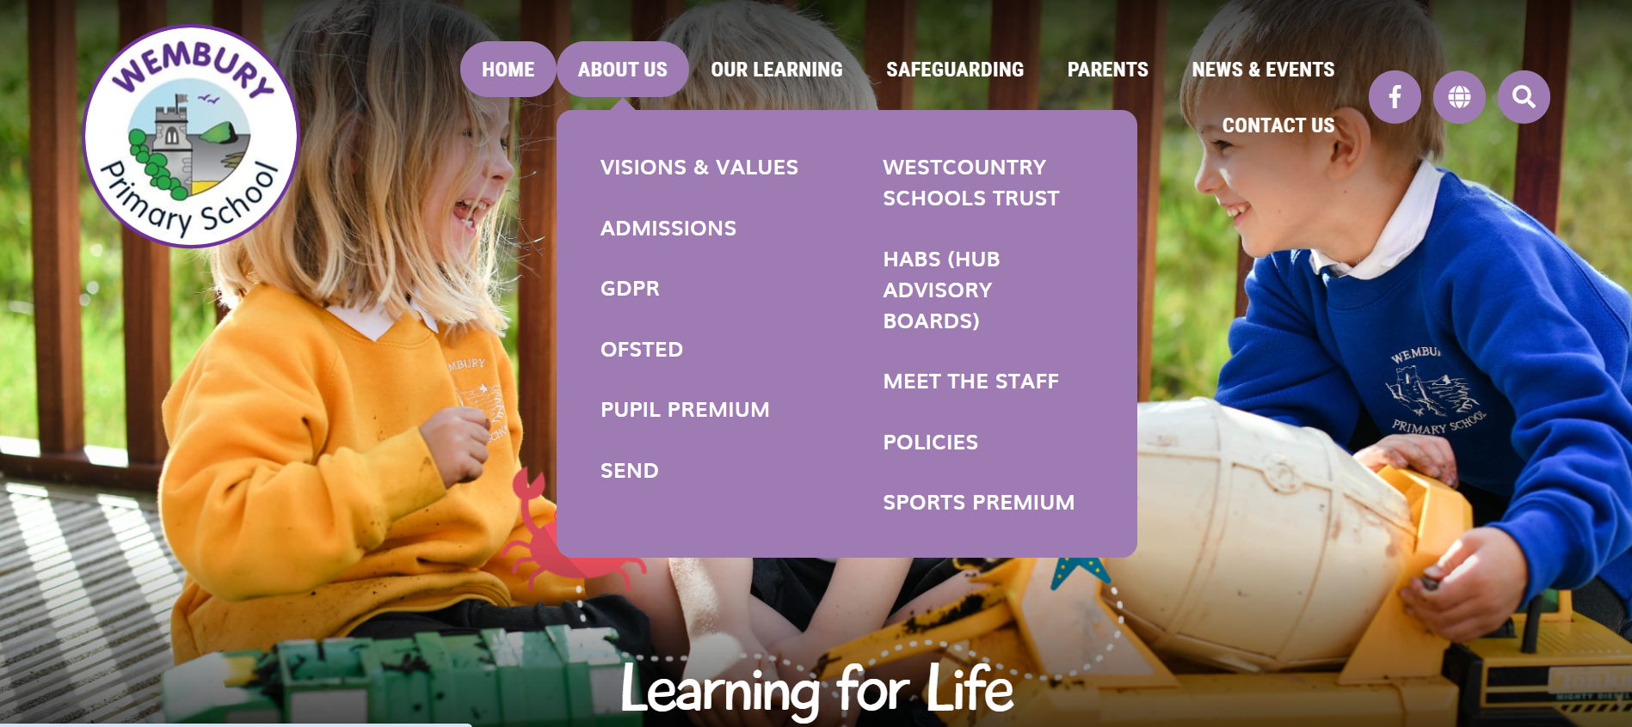
Where can I find more information about Wembury Primary’s approach to supporting children with SEND?
Please visit www.wemburyprimary.co.uk
Go here first

Slide 15






Where can I go for further advice?
The SEN Code of Practice guide for parents https://www.gov.uk/government/publications/send-guide-for-parents-and-carers
Plymouth Home Address
Devon Home Address
There are also lots of websites for specific needs that can be recommended. Please ask for further advice. Here are a few that might be of use:

Slide 16


Where do I go to find information about the Local Offer for children with SEND?
Click on the image to take you to Plymouth or Devon’s Local Offer Website

Slide 17

What can I do if I am not happy with the school’s provision? How can I share my concerns?
If you are not happy with the school’s provision for your child, then we recommend the following steps; Talk to your child’s class teacher Share your concerns with the SENDCO or Head Teacher If you feel that your concerns are still not resolved, then please visit our website where details can be found on how to raise a complaint within the complaints policy.

