Slide 1
Welcome to
Year 4

Slide 2
Y4
Team
Mrs Jackson
Teacher
Deputy Head
Miss Brookes
Mrs O’Carroll
Miss Summers
Mrs Withers
Mrs Walsh
Teacher
Mrs Brooking
HLTA

Slide 3
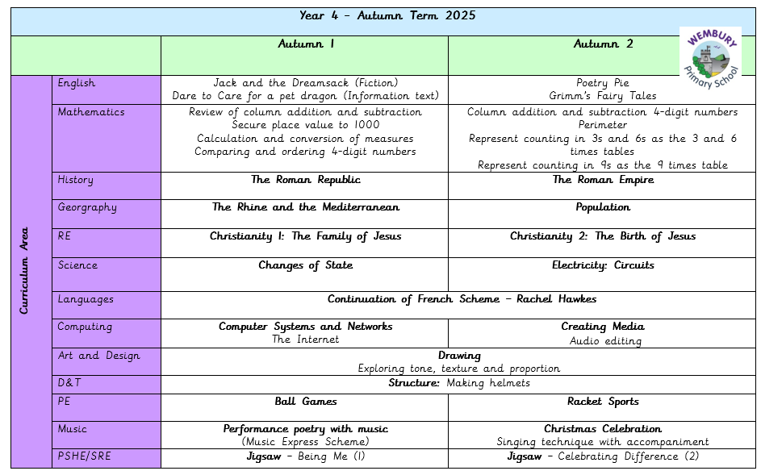

Slide 4
PSHE (Personal, Social, Health & Emotional)
Wembury uses Jigsaw – this is a whole school scheme of work.
Please encourage your child to talk to any adult in school.
Respect each other – we are all different.

Slide 5
Behaviour and Relationship Policy
Wembury Primary School has 3 simple rules:
‘Be Ready, Be Respectful and Be Safe’
which can be applied to a variety of situations and are taught and modelled explicitly.
‘Our Behaviour Horizon’
Wembury Primary Behaviour and Relationship Policy

Slide 6

Working Together
We will contact you if your child is frequently having difficulty following class and school rules, so that we can work together to improve the situation. This will ensure a successful learning experience for your child and others in the class.
Also, if there is anything that is worrying your child, please let us know as soon as possible so that we can support appropriately:
y4@wembury-primary.devon.sch.uk

Slide 7
Homework Arrangements
Homework will be sent home on a Wednesday and, where possible, this will also be emailed home.
At least minutes of reading everyday is crucial (books can be returned whenever they are completed) If children score 80% or more they will receive a sticker for their bookmark.
Maths and Spellings will be set each week.
Spellings will build on class learning and will be assessed in class the following Monday. Spellings sent home will include 5 focus words and 5 words from the Year 3/4 list.

Slide 8
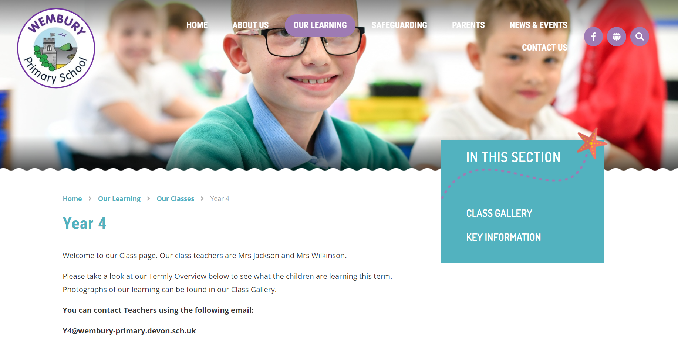
www.wemburyprimary.co.uk
Website/app – please check for updates
Class Gallery – photographs
Curriculum Overviews for each term
Key Info - PowerPoints/Information

Slide 9
Supporting Children with Special Needs
We strive to be a fully inclusive school and provide children with support to overcome any barriers to their learning.
Class teachers will communicate regularly with parents to identify and discuss support for children with Special Educational Needs.
If you have any concerns regarding your child’s academic or emotional needs then please discuss with their class teacher initially. You can also discuss any issues with the school’s Special Educational Needs Coordinators (SENCOs).
Mrs Pip Edwards, Mrs Becky Booth and Mrs Claire Walsh are our SENDCOs.
Please see the school’s website and SEND policy and further support.

Slide 10
Multiplication Tables Check (MTC)
Summer Term
The MTC is an on-screen national check.
25 times tables questions.
6 seconds to answer each question.
On average, the check should take no longer than 5 minutes to complete.

Slide 11
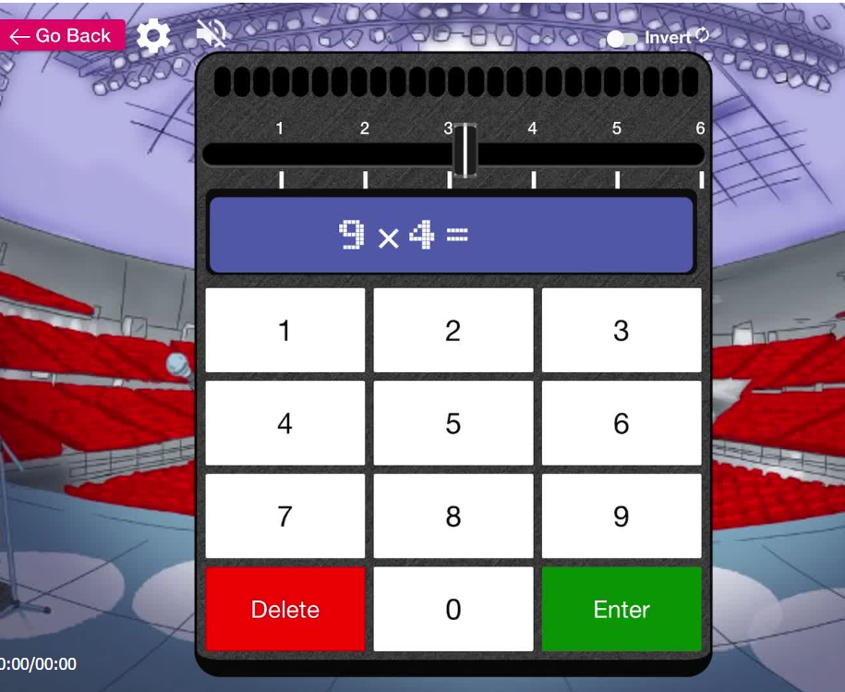
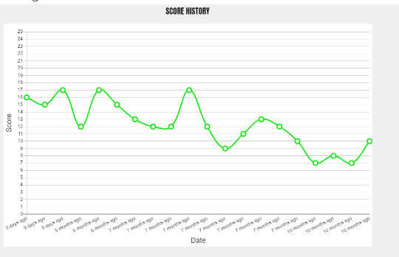
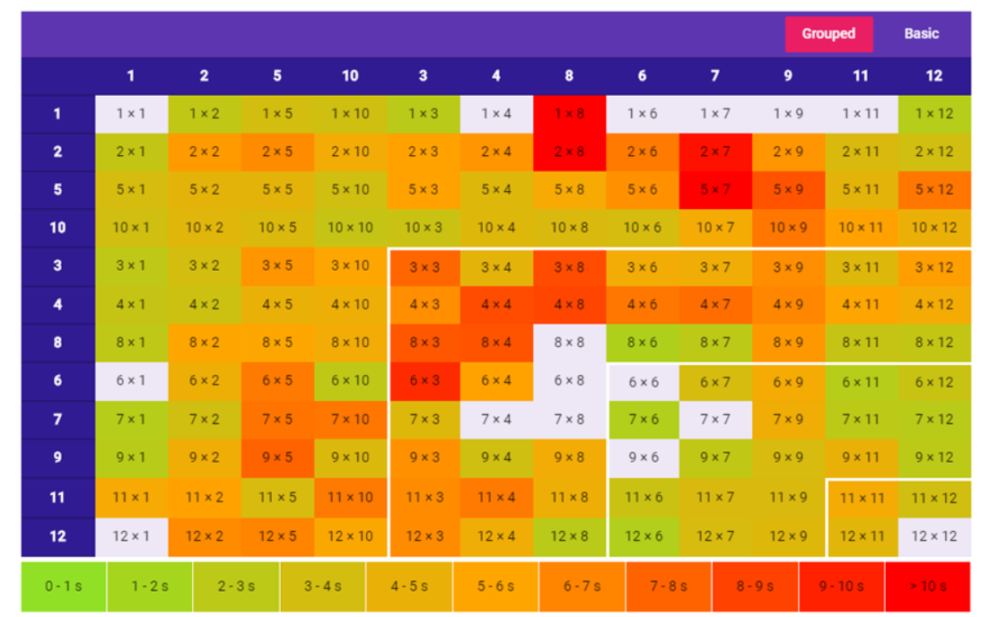

Slide 12

Pixies Holt – 1st – 3rd July (2 night residential)
Further details to follow later in the term
Cost will be around £200. £100 deposit required by end of October.

Slide 13

The Wembury Oracy Project Continues!
The ability to express one’s self fluently and grammatically in speech
Inter-thinking: Learning to talk; learning through talk.

Slide 14
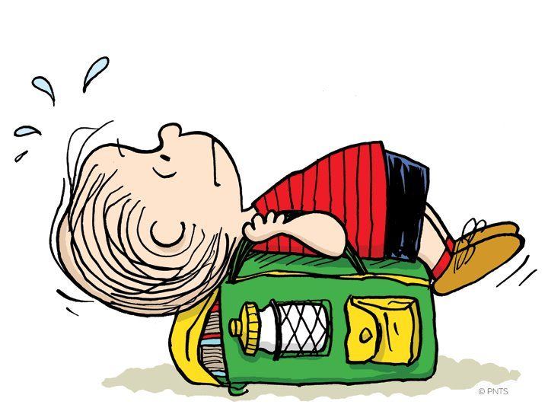

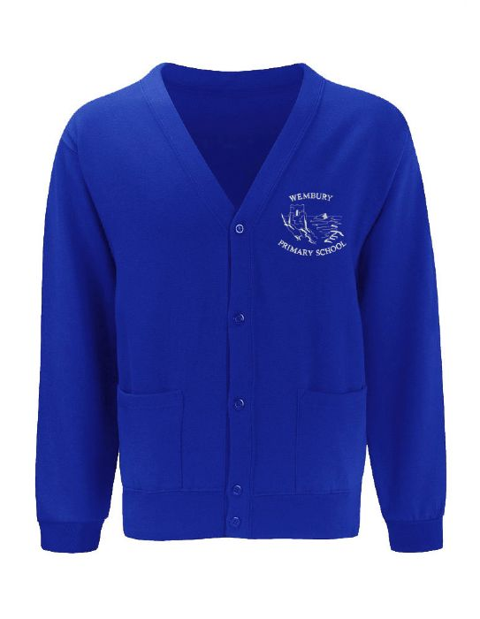

Bags
Only bring necessary items to school. Bags are kept in lockers and PE bags need to be in school every day please
Shoes
Children to wear appropriate black school shoes.
Sweatshirts and Cardigans
Should bear the school logo.
Art
It may get messy! We will let you know if this is necessary.

Slide 15
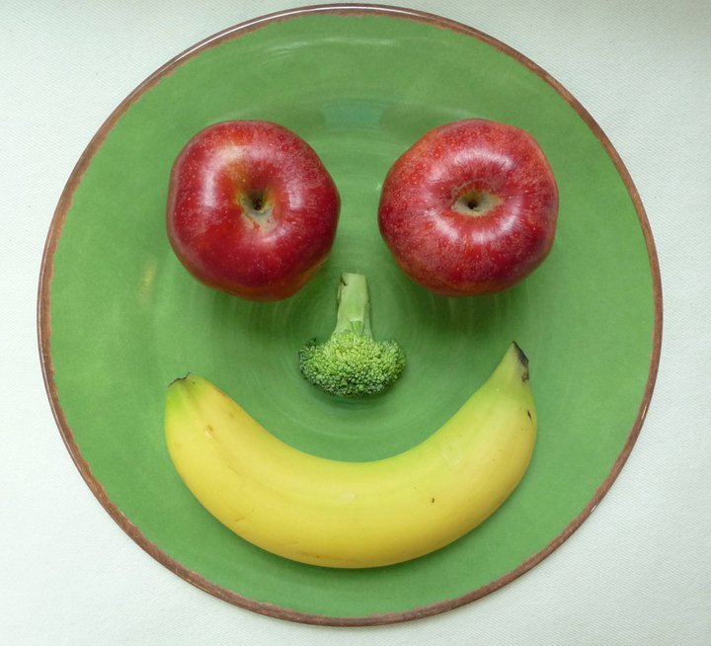


Snack Time
Please bring a healthy snack to school:
Fresh fruit, raw vegetables, plain crackers, plain rice cakes or breadsticks.

Slide 16

Thank you for coming!
We are looking forward to a fantastic year with our fabulous
STAR class!

