Slide 1
Welcome to
Year 6

Slide 2
Y6
Team
Mr Taylor
Class Teacher
Mrs Brooking
Higher Level Teaching
Assistant
Mrs Kitchen
Teaching Assistant
Mrs Felton
Teaching Assistant
Mrs Moxham
Higher level Teaching
Assistant

Slide 3
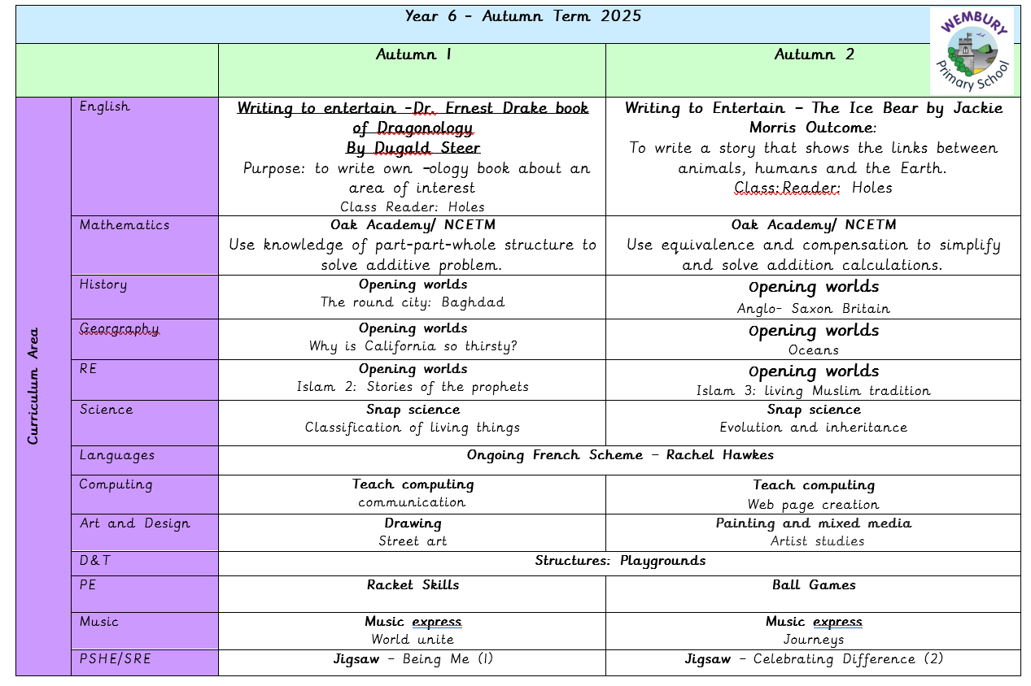

Slide 4
Behaviour and Relationship Policy
Wembury Primary School has 3 simple rules:
‘Be Ready, Be Respectful and Be Safe’
which can be applied to a variety of situations and are taught and modelled explicitly.
‘Our Behaviour Horizon’
Within each class, all children will start on green at the beginning of each lesson.
Wembury Primary Behaviour and Relationship Policy

Slide 5

Working Together
We will contact you if your child is frequently having difficulty following class and school rules, so that we can work together to improve the situation. This will ensure a successful learning experience for your child and others in the class.
Also, if there is anything that is worrying your child, please let us know as soon as possible so that we can support appropriately:
y6@wembury-primary.devon.sch.uk

Slide 6
Homework Arrangements
Homework will be sent home on a Wednesday and, where possible, this will also be emailed home.
30 minutes of reading everyday is crucial (books can be returned whenever they are completed) If children score 80% or more they will receive a sticker for their bookmark.
Maths and Spellings will be set each week.
Spellings will build on class learning and will be assessed in class the following Tuesday. Spellings sent home will also include previously learnt spellings (5 new, 5 previously learnt).

Slide 7
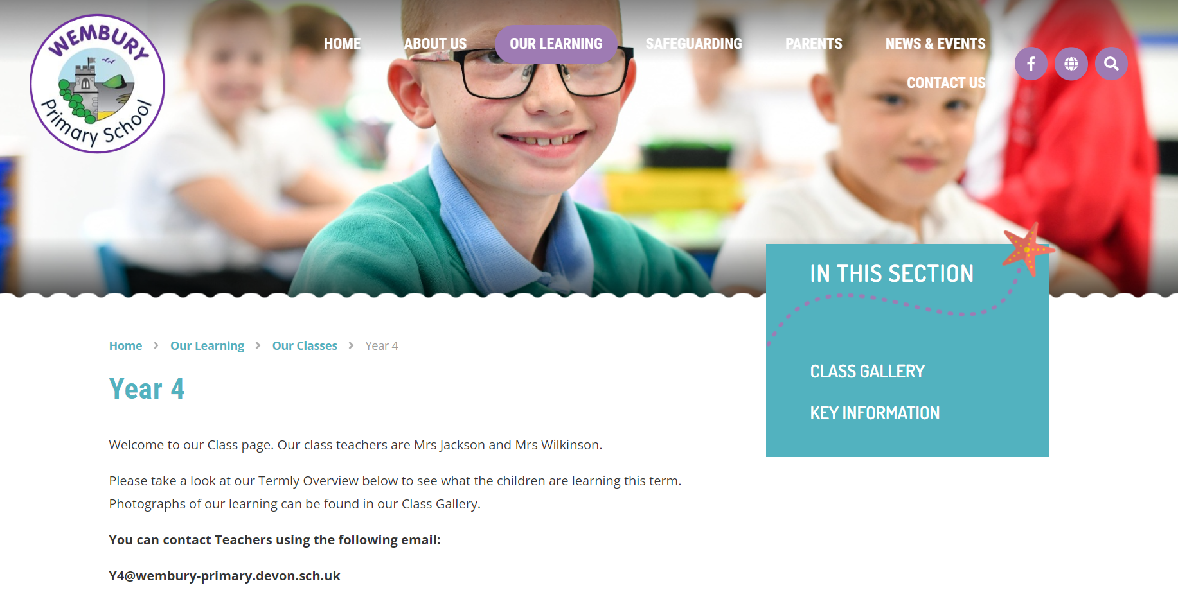
www.wemburyprimary.co.uk
Website/app – please check for updates
Class Gallery – photographs
Curriculum Overviews for each term
Key Info - PowerPoints/Information

Slide 8
Supporting Children with Special Needs
We strive to be a fully inclusive school and provide children with support to overcome any barriers to their learning.
Class teachers will communicate regularly with parents to identify and discuss support for children with Special Educational Needs.
If you have any concerns regarding your child’s academic or emotional needs then please discuss with their class teacher initially. You can also discuss any issues with the school’s Special Educational Needs Coordinators (SENCOs).
Mrs Pip Edwards, Mrs Becky Booth and Mrs Claire Walsh are our SENDCOs.
Please see the school’s website and SEND policy and further support.

Slide 9
Residential
Yet to be determined
A few options are being considered, focusing on minimising costs whilst still being an enjoyable and memorable experience for the children
Aiming to be week after SATS and prior to May half term

Slide 10
SATS
Week of the 11th of May 2026
Thinking of SATS as a celebration of what your children have learnt through their learning journeys up to this point.
Big focus on working together to help provide the best opportunities for the children.
Mock SATS papers to be completed in coming weeks.
Intervention groups

Slide 11
Applying for secondary school!
Deadline to apply is the 31st of October 2025
Offer day Monday 2nd of March
Apply for a secondary school place | PLYMOUTH.GOV.UK

Slide 12
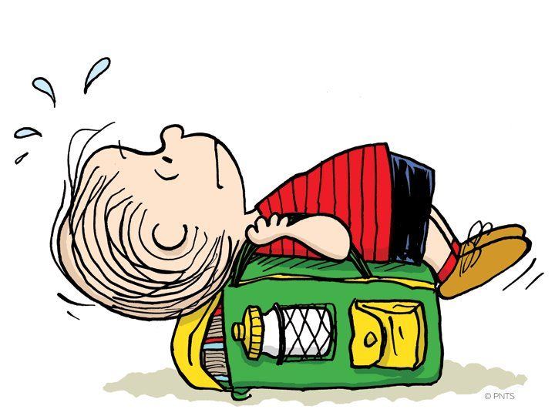

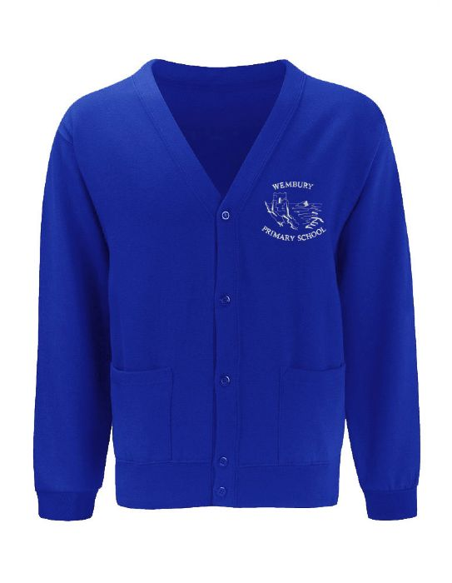

Bags
Only bring necessary items to school. Bags are kept in lockers and PE bags need to be in school every day please
Shoes
Children to wear appropriate black school shoes.
Sweatshirts and Cardigans
Should bear the school logo.
Art
It may get messy! We will let you know if this is necessary.

Slide 13
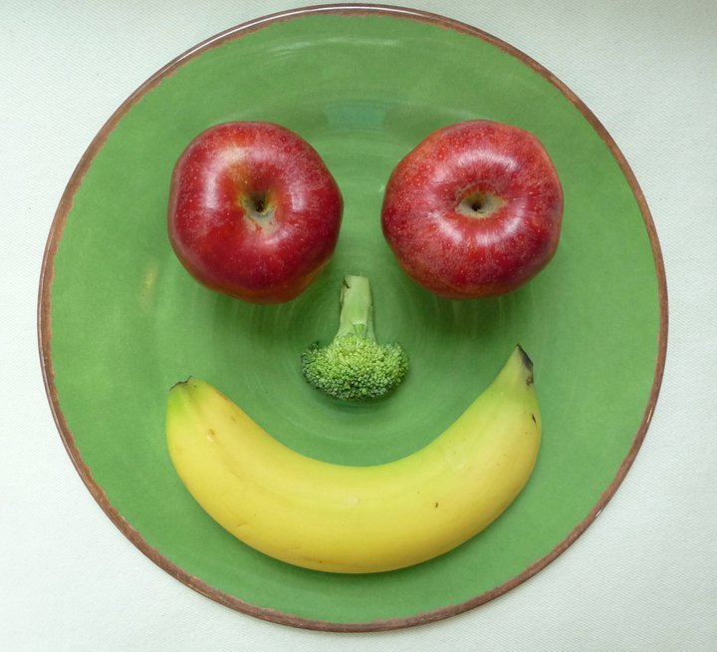


Snack Time
Please bring a healthy snack to school:
Fresh fruit, raw vegetables, plain crackers, plain rice cakes or breadsticks.

Slide 14

Thank you for coming!
We are looking forward to a fantastic year with our fabulous
STAR class!

