Slide 1
Welcome to
Year 4

Slide 2
Y4
Team
Mrs Durbauree
Mrs Wotton
Miss Cann
Mrs Jackson

Slide 3
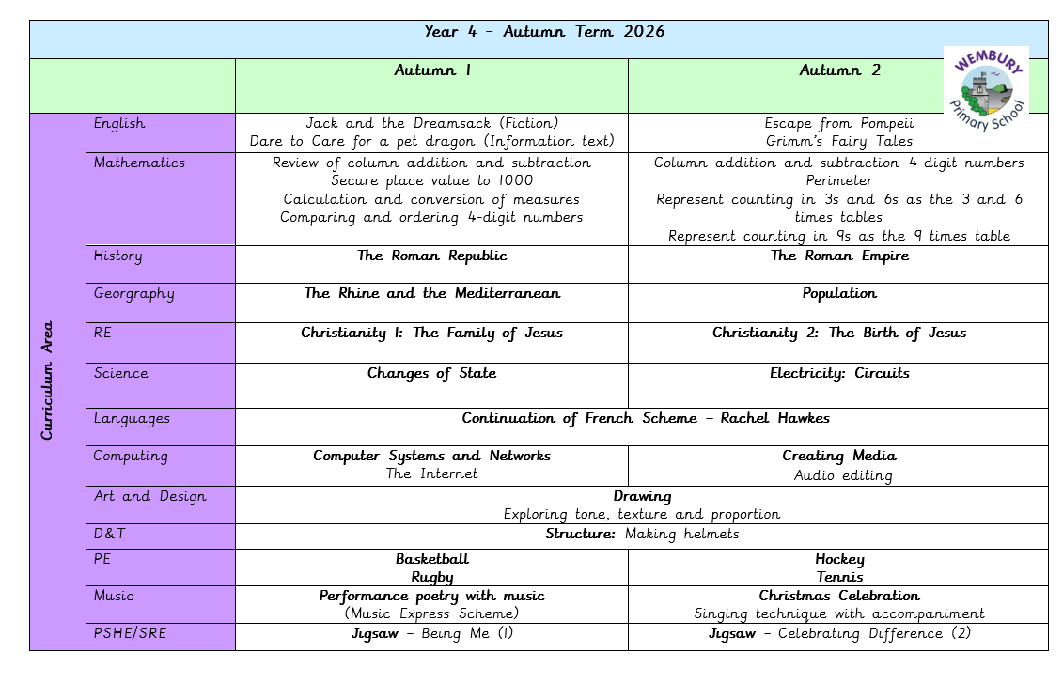

Slide 4

Communication
Our main form of communication now is via ClassDojo. This is a two - way platform where we can communicate with yourselves.

Slide 5

Behaviour and Relationship Policy
Wembury Primary School has 3 simple rules:
‘Be Ready, Be Respectful and Be Safe’
‘Our Behaviour Horizon’

Slide 6
Working together in partnership
At Wembury we recognise the importance of:
Strong relationships
The need for adaptations for different needs
Consistent routines and structures

Slide 7
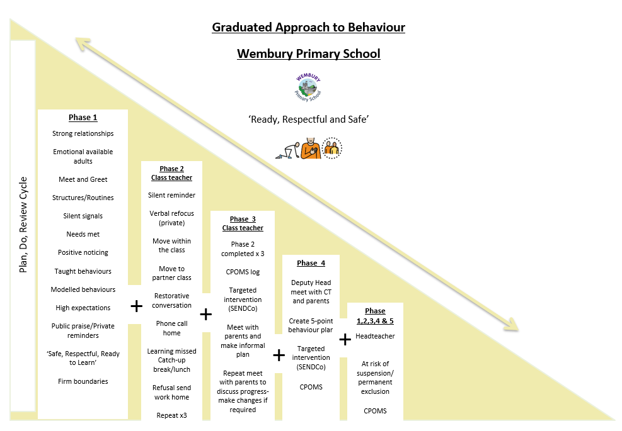
Our Graduated Behaviour Approach

Slide 8
PSHE (Personal, Social, Health & Emotional)
Wembury uses Jigsaw – this is a whole school scheme of work.
Please encourage your child to talk to any adult in school.
RSE – taught in the Summer term.

Slide 9
Homework Arrangements
Homework will be sent home on a Wednesday and, where possible, this will also be shared via Dojo.
At least 15 minutes of reading everyday is crucial (books can be returned whenever they are completed) If children score 80% or or more they will be rewarded with sticker or stamp.
Maths and Spellings will be set each week.
Spellings will build on class learning and will be assessed in class the following week. Spellings sent home will include 5 focus words and 5 words from the Year 3/4 list.

Slide 10
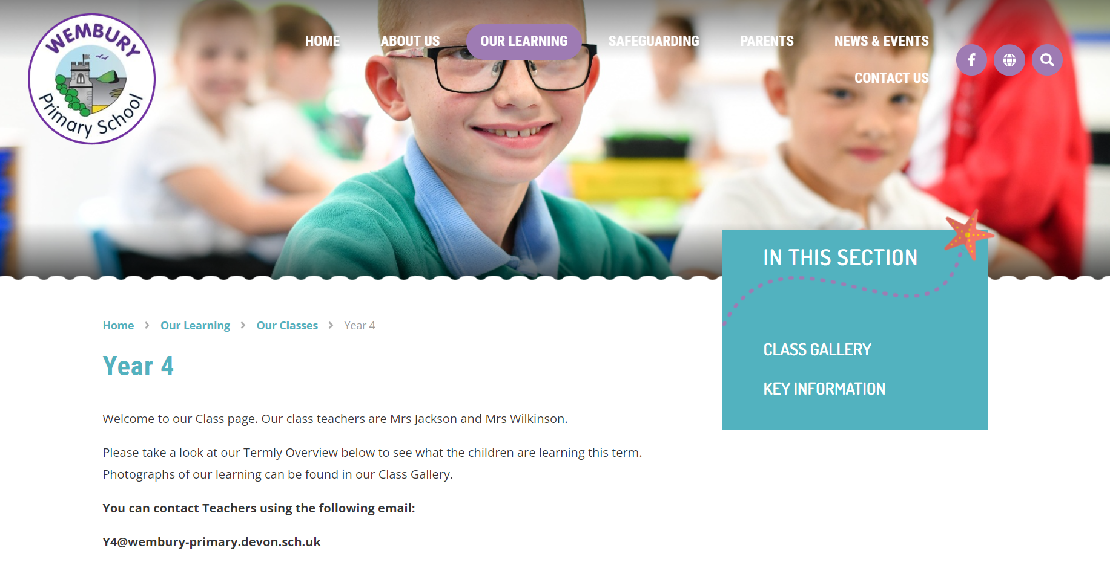
www.wemburyprimary.co.uk
Website – please check for information e.g. term
dates, curriculum subject information and
safeguarding information.
Curriculum Overviews for each term
Key Info - PowerPoints/Information

Slide 11
Supporting Children with Special Needs
We strive to be a fully inclusive school and provide children with support to overcome any barriers to their learning.
Class teachers will communicate regularly with parents to identify and discuss support for children with Special Educational Needs.
If you have any concerns regarding your child’s academic or emotional needs then please discuss with their class teacher initially. You can also discuss any issues with our school’s Special Educational Needs Coordinator (Mrs Edwards).
Please see the school’s website and SEND policy and further support.

Slide 12
Multiplication Tables Check (MTC)
Summer Term
The MTC is an on-screen national check.
25 times tables questions.
6 seconds to answer each question.
On average, the check should take no longer than 5 minutes to complete.

Slide 13
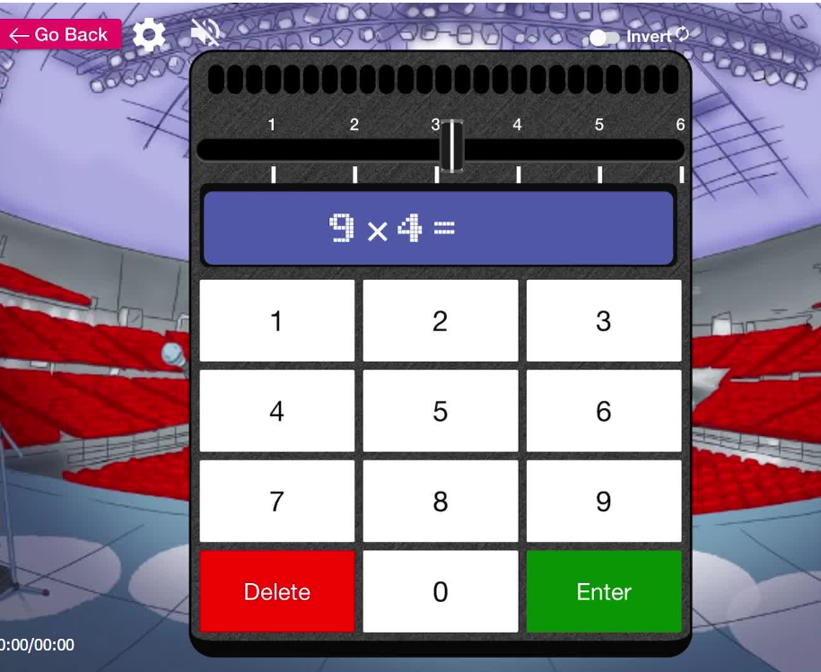
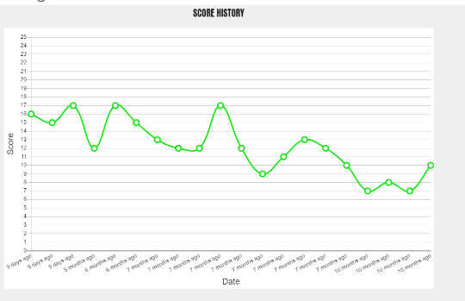
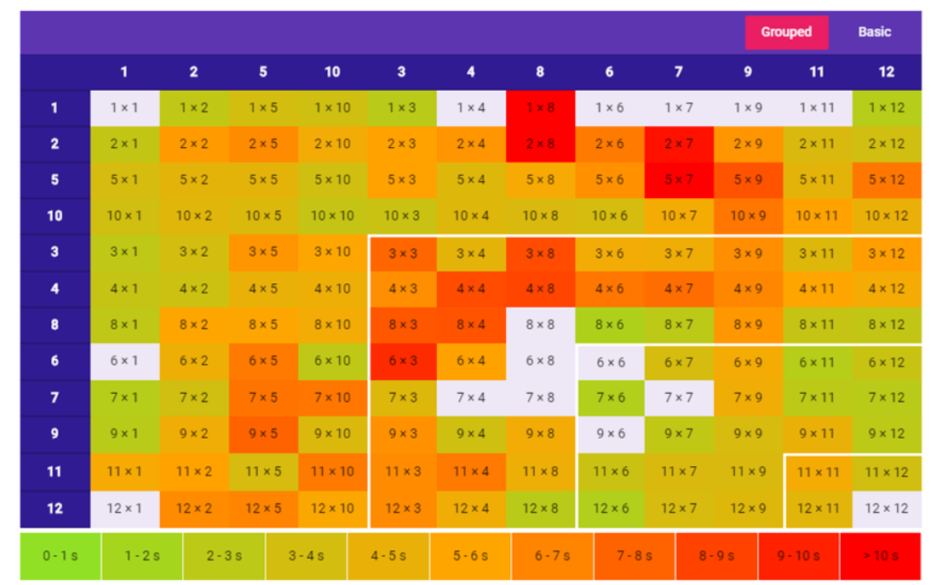

Slide 14
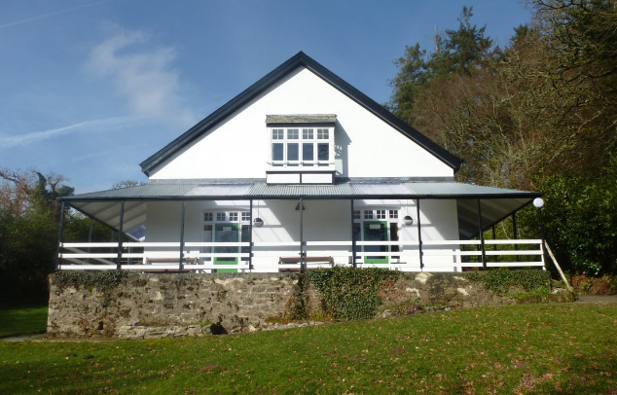
Pixies Holt – 30th – 1st July (2 night residential)
Further details to follow later in the term
Cost will be around £200. £100 deposit required by end of November.

Slide 15
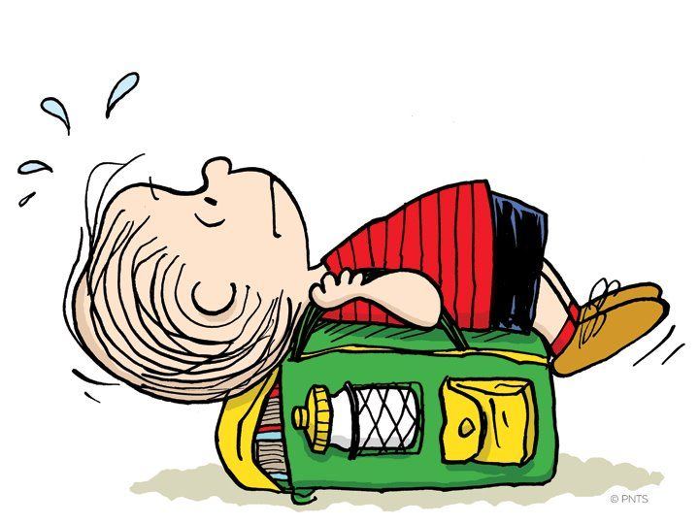

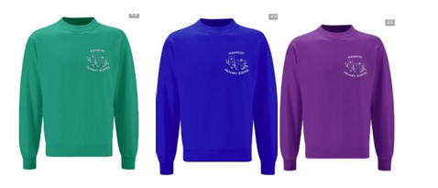
Bags
Only bring necessary items to school. Bags are kept in lockers and PE bags need to be in school every day please
Shoes
Children to wear appropriate black school shoes.
Sweatshirts and Cardigans
From September 2026 – blue, jade or purple jumpers to be purchased.
PE Kit
White t-shirt
Black shorts
Joggers or leggings for the Autumn/winter term
No jewellery

Slide 16
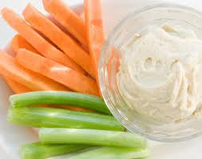
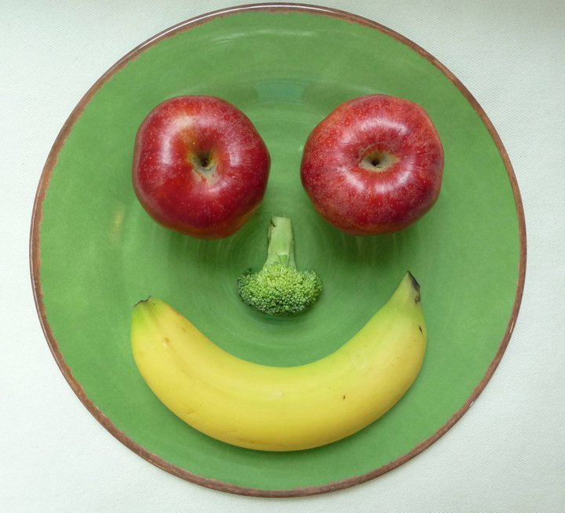

Snack Time
Please bring a healthy snack to school:
Fresh fruit, raw vegetables, plain crackers, plain rice cakes or breadsticks.
Friday – treat day.

Slide 17

Thank you for coming!
We are looking forward to a fantastic year with our fabulous class!

